Slide 1

Data Visualization
Ali YASAR, March 2016, Istanbul
Introduction to Data Science, Computer Engineering
[Research Study]
(2015-2016 Academic Year Spring Semester)

Slide 2
Table of Contents
01
What are the characteristics of a good & bad visualisation?
03
Some visualisation tools, libraries (d3js, tableau)
02
04
What about Python packages? (matplotlib, seaborn)
Why is visualisation important?

Slide 3
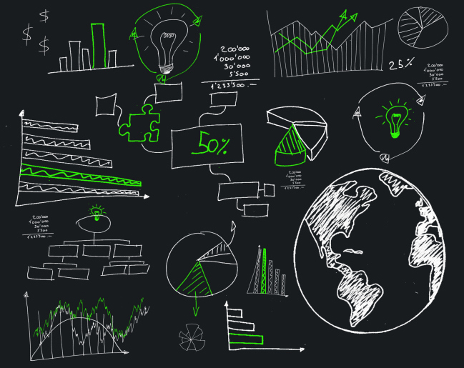
What is data visualization?
Data visualization is a graphical representation of information.
Data visualization is a general term that describes any effort to help people understand the significance of data by placing it in a visual context.
Main goal of data visualization is to communicate information clearly and effectively through graphical means.
It doesn’t mean that data visualization needs to look boring to be functional or extremely sophisticated to look beautiful.
Designers often fail to achieve a balance between form and function, creating gorgeous data visualizations which fail to serve their main purpose — to communicate information”.

Slide 4
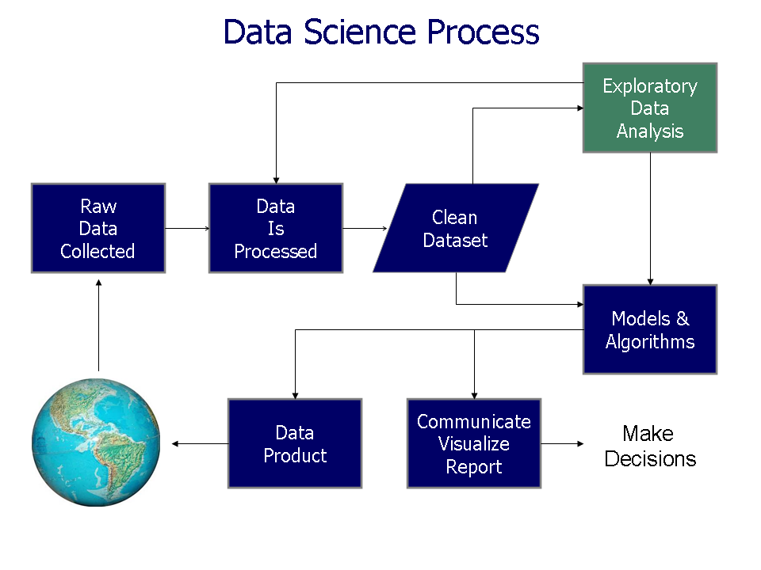
How to collect Data?

Slide 5

Real-World Data Acquisition and Visualization

Slide 6
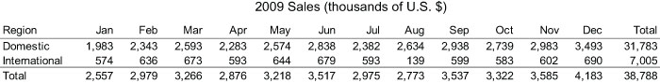
Data Visualization for Human Perception
"a picture is worth a thousand words"

Slide 7
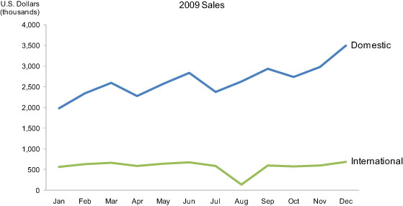
Data Visualization for Human Perception
Now look at the following picture of the same information in the form of a line graph:

Slide 8
Data Visualization for Human Perception
What these numbers could not communicate when presented as text in a table, which our brains interpret through the use of verbal processing, becomes visible and understandable when communicated visually. This is the power of "data visualization."

Slide 9
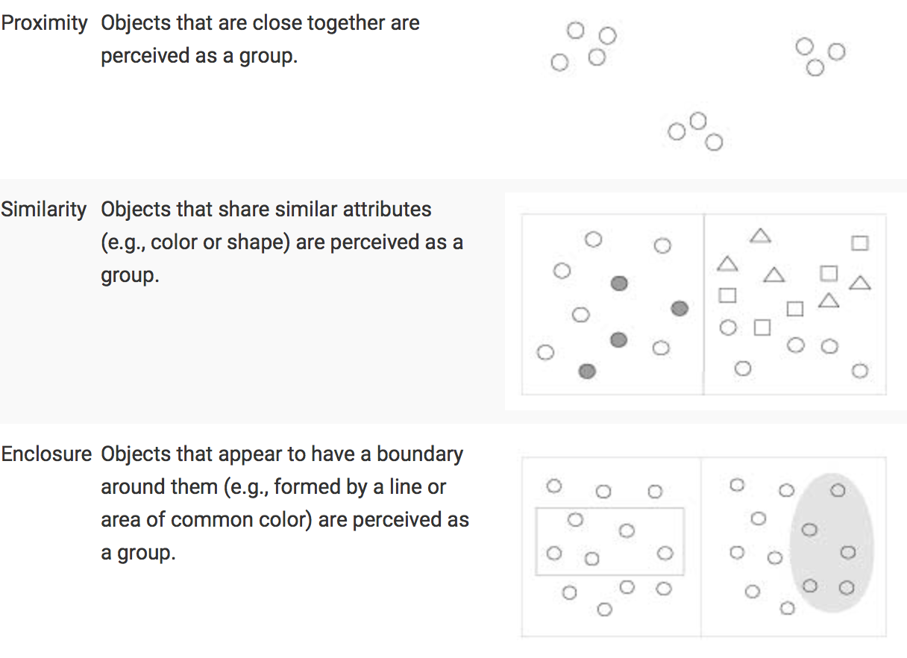
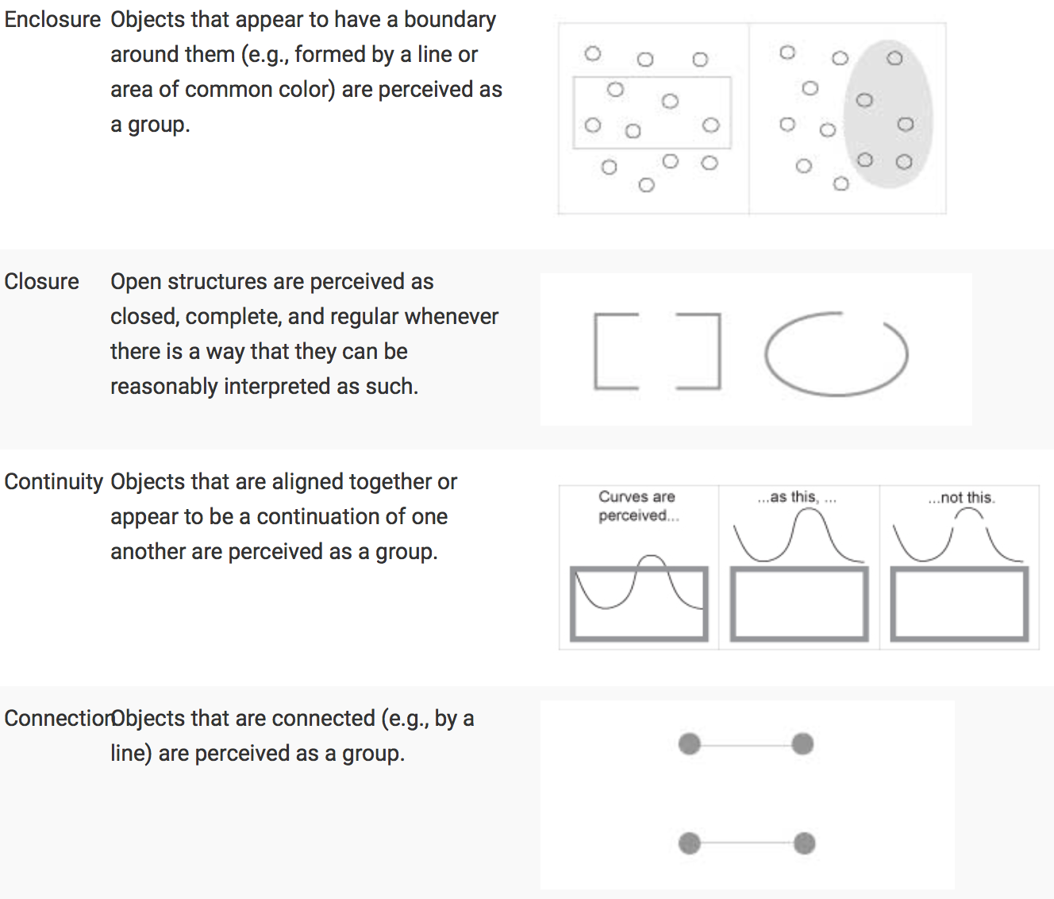
Data Visualization for Human Perception
What these numbers could not communicate when presented as text in a table, which our brains interpret through the use of verbal processing, becomes visible and understandable when communicated visually. This is the power of "data visualization."

Slide 10
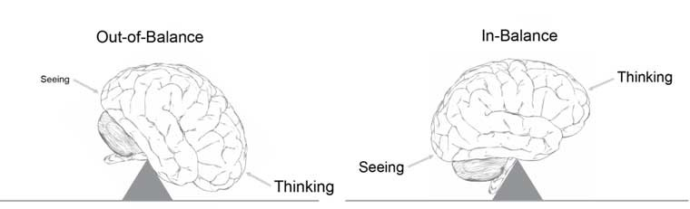
Advantages of Data Visualization
To achieve this goal, should achieve the following:
Easy to compare the quantities.
Represents the quantities accurately.
Makes it easy to see the ranked order of values, such as from the leading cause of death to the least.

Slide 11
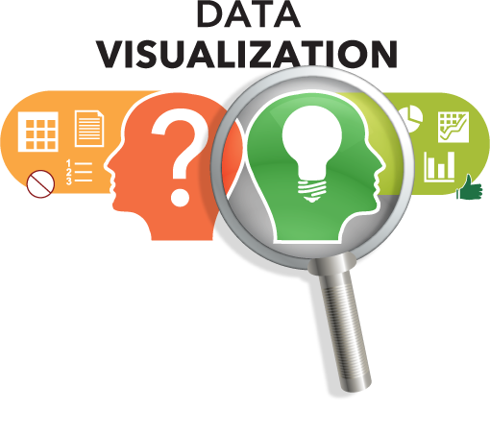
Why Data Visualization is Important?
Because of the way the human brain processes information, using charts or graphs to visualize large complex data is easier than over spreadsheets or reports.
Data visualization is a quick, easy way to spread in a universal manner – and you can experiment with different scenarios by making small configuration.
Data visualization can also:
Help you understand which products to place where.
Guess sales.
Describe which factors impress customer behaviour.

Slide 12
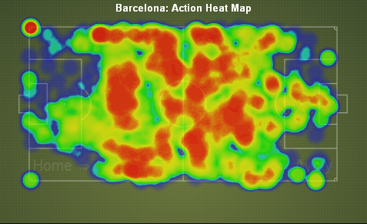
Real Life Examples
Squawka Football Stats
Football teams use it in half of & end of the match.
trulia.com (Analysing environment as a Crime reports for houses.)
Live NYC Traffic

Slide 13
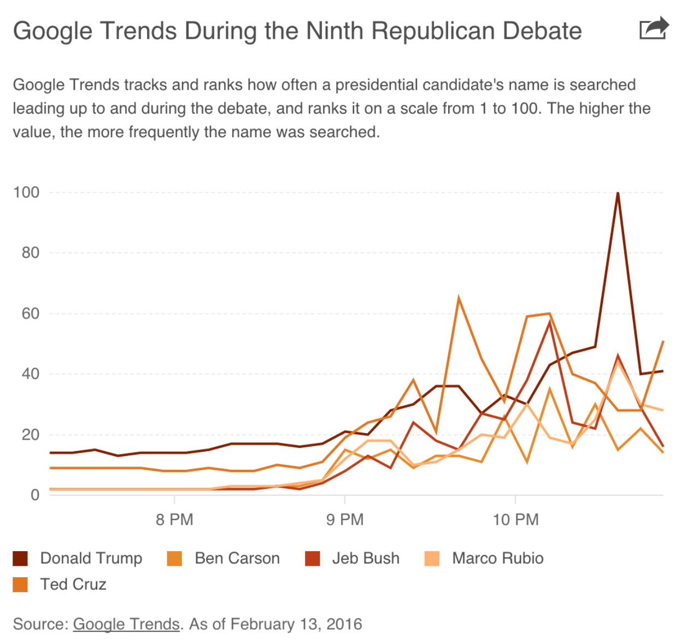
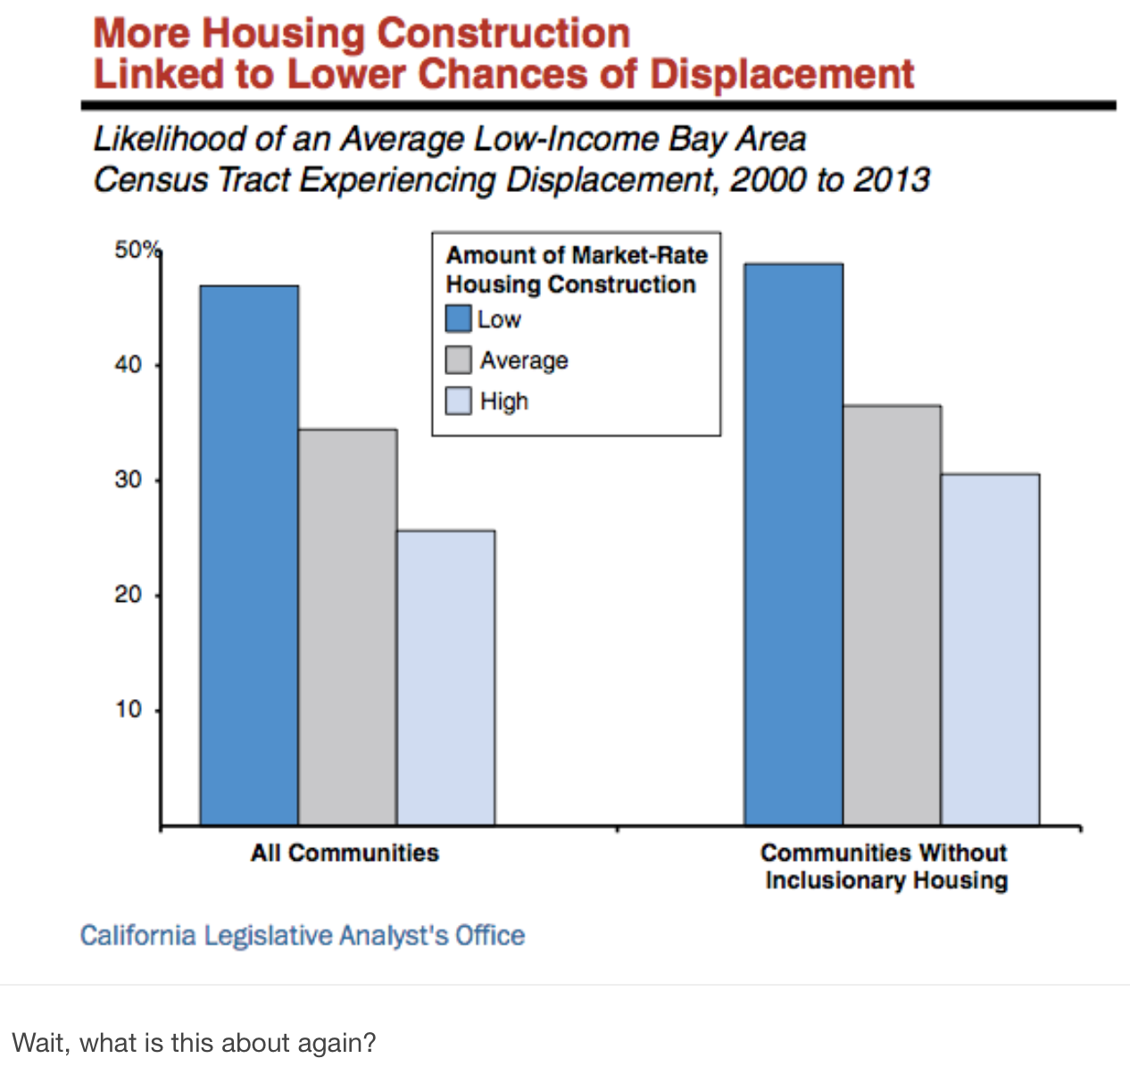
Bad Examples

Slide 14
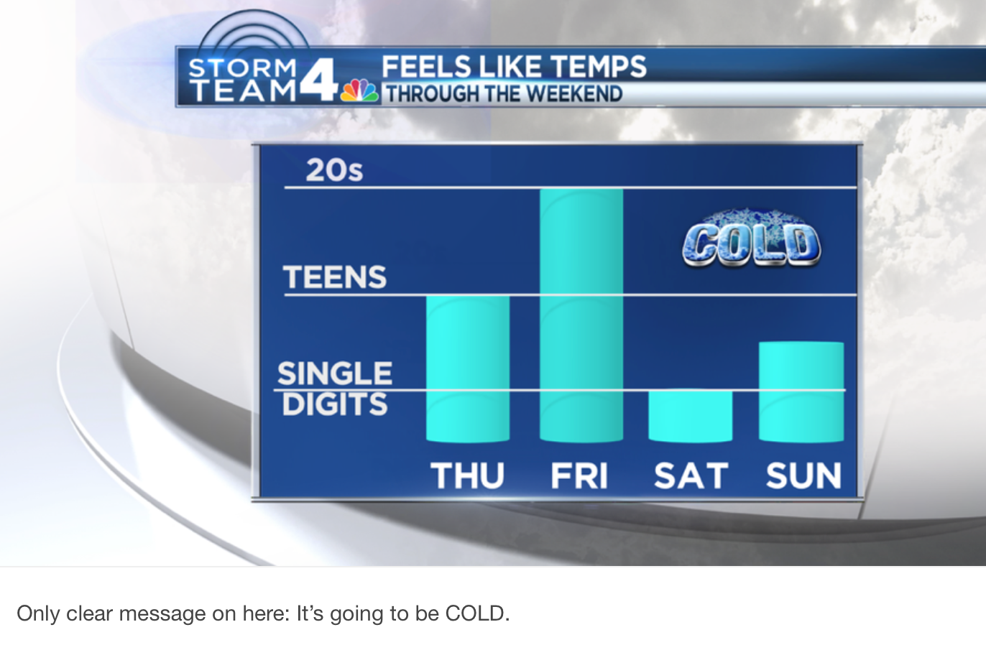
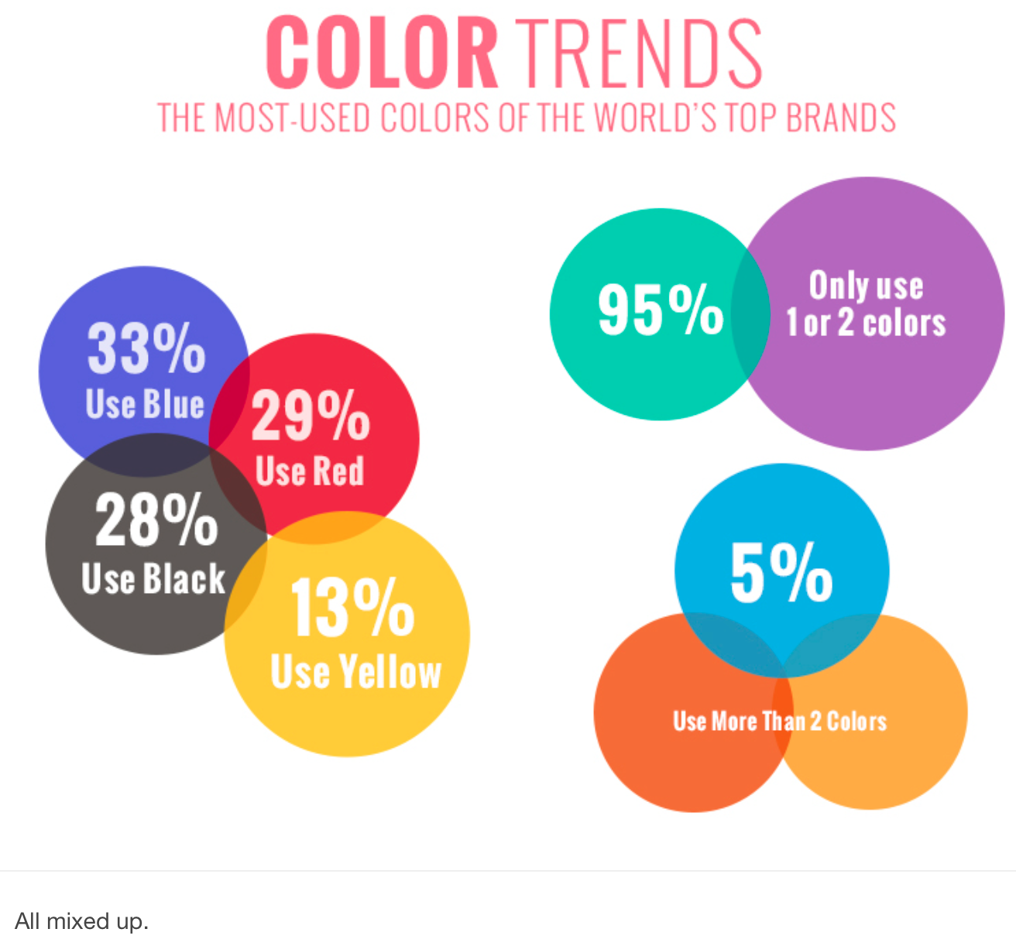
Bad Examples

Slide 15
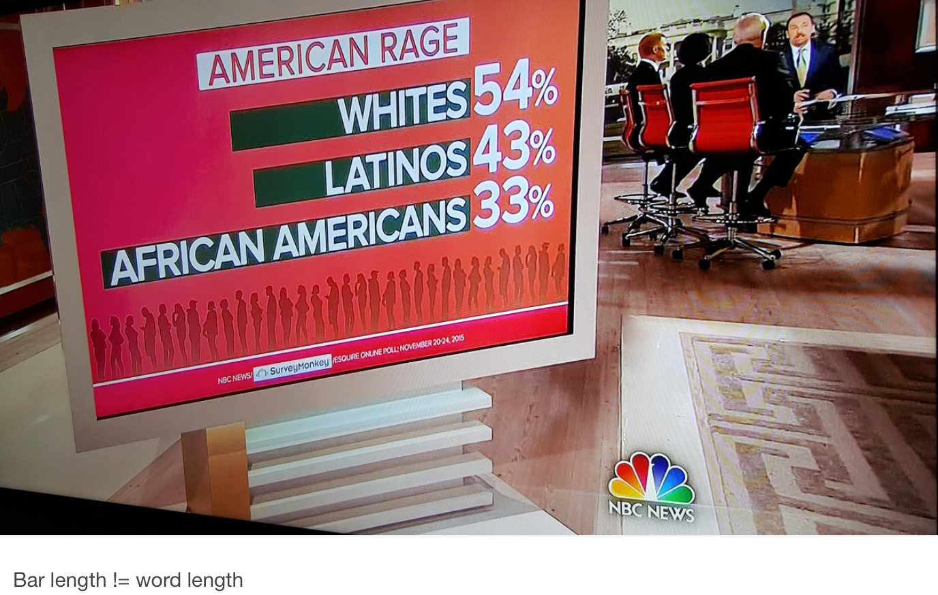
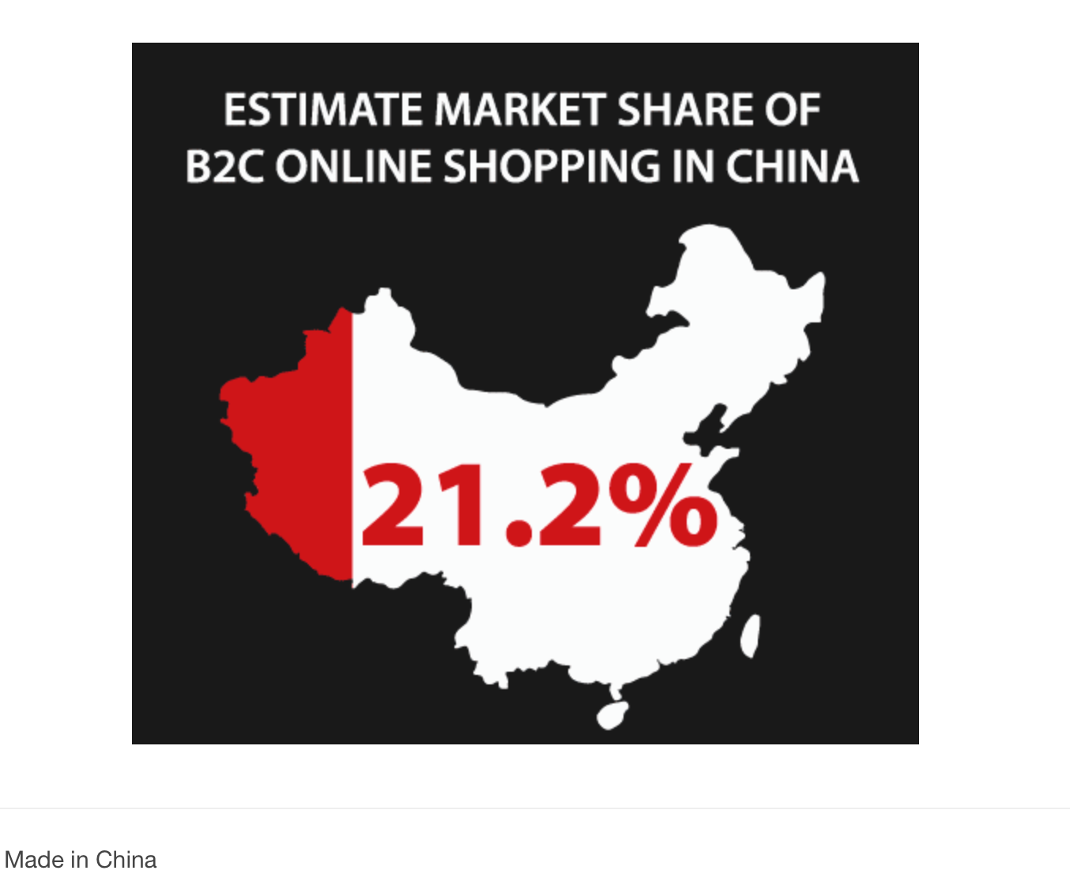
Bad Examples

Slide 16
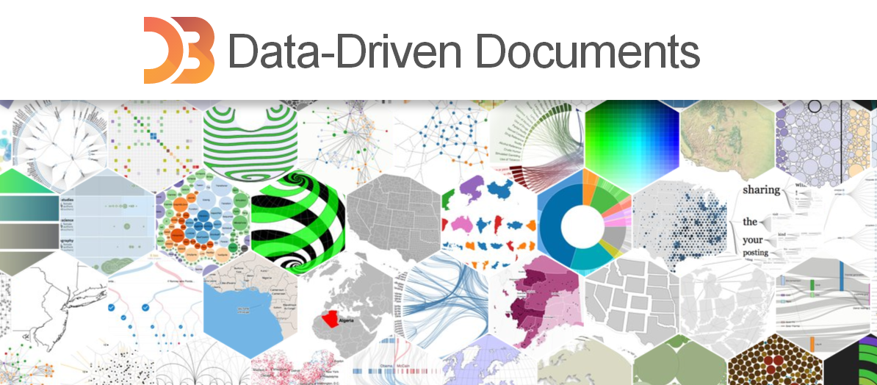
d3.js (Data Driven Documents)
A JavaScript library for manipulating documents based on data.
Helps you bring data to life using HTML, SVG, and CSS.
Gives you the full capabilities of modern browsers without tying yourself to a proprietary framework, combining powerful visualisation components and a data-driven approach to DOM manipulation.
Allows you to build highly customised graphics.

Slide 17
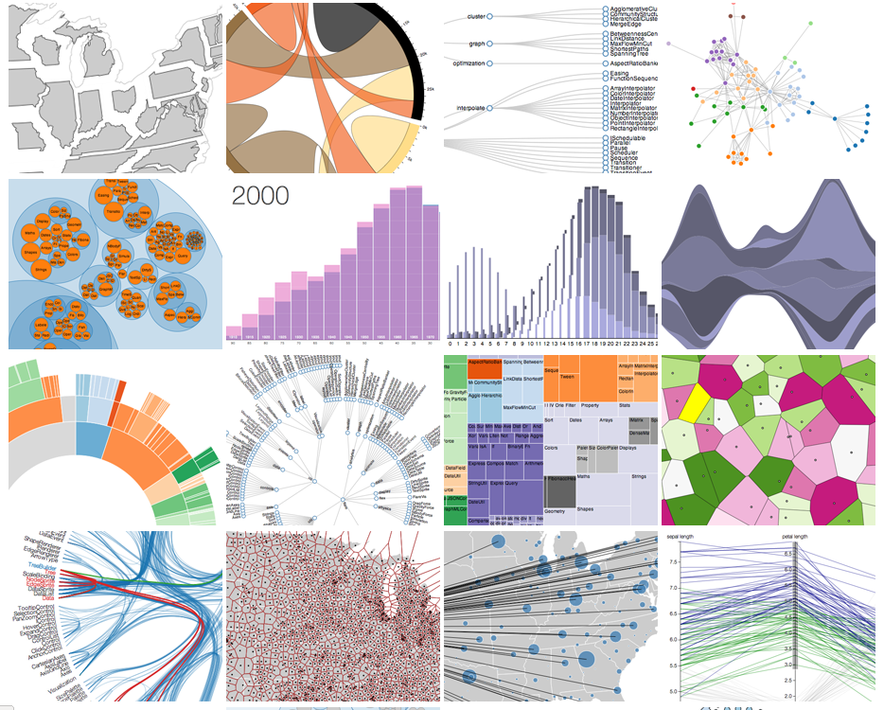
d3.js (Data Driven Documents)

Slide 18
What about tools and libraries?
d3.js (JavaScript library for manipulating documents based on data)
Numpy (NumPy is the fundamental package for scientific computing)
matplotlib (2D plotting library)
seaborn (Visualization library based on matplotlib)
GapMinder

Slide 19
References
1) http://bl.ocks.org/mbostock/1153292
2) https://www.interaction-design.org/literature/book/the-encyclopedia-of-human-computer-interaction-2nd-ed/data-visualization-for-human-perception
3) http://www.nytimes.com/interactive/2013/05/25/sunday-review/corporate-taxes.html?_r=0
4) http://www.nytimes.com/interactive/2012/11/02/us/politics/paths-to-the-white-house.html?_r=0
5) http://tumblebolt.com/speedy.html
6) https://support.spatialkey.com/spatialkey-sample-csv-data/
7) http://www.sas.com/en_us/insights/big-data/data-visualization.html
8) https://plot.ly/python/plot-data-from-csv/
9) https://plot.ly/python/
10) http://blog.hubspot.com/marketing/great-data-visualization-examples
11) http://www.webdesignerdepot.com/2009/06/50-great-examples-of-data-visualization/
12) http://blog.visual.ly/five-best-data-visualization-examples-content-marketers/
13) http://www.cssdesignawards.com/articles/interactive-data-visualization-examples-tools/58/
14) http://blog.udacity.com/2015/01/15-data-visualizations-will-blow-mind.html
15) https://congosto.cartodb.com/viz/e5da12e2-9fe7-11e4-bc43-0e853d047bba/public_map
16) https://github.com/mwaskom/seaborn
17) https://plot.ly/495/%7EDreamshot/
18) http://www.darkhorseanalytics.com/blog/data-looks-better-naked/
19) http://www.randalolson.com/2014/06/28/how-to-make-beautiful-data-visualizations-in-python-with-matplotlib/

